Slide 1
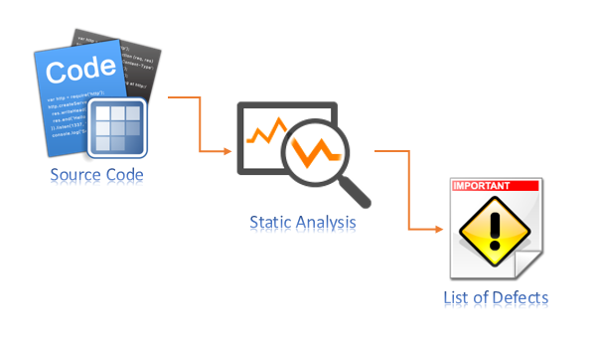
Static Analysis

Slide 2
Outline
White Box Testing
Code Coverage
What is Static Analysis?
How does it work?
Static Analysis Tools

Slide 3
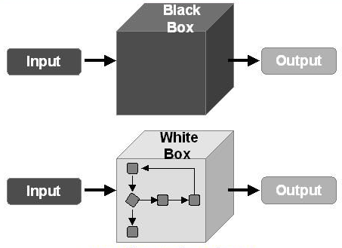
The Power of Source Code
Enter 10
Result 20
Back Box Testing
Typically, your QA person
Impartial team,
No knowledge of the internal workings of the system
White box testing
Testers have intimate knowledge of the specifications, design,
Often done by the original developers
Security consultants often get source code access too
Code Inspections
aka “Technical Reviews”, “Code Reviews”
Stepping through code with security in mind
Method:
10 x 2
10 + 10
(10 x 3) - 10
Enter 10
Result 20

Slide 4

What is White Box testing?
Testing of a software application’s internal code and infrastructure.
It focuses primarily on strengthening security, the flow of inputs and outputs through the application, and improving design and usability.
Who does this testing?
Developers
Someone who understands the system
Someone who know what the system is supposed to do
It involves testing a series of predefined inputs against expected or desired outputs so that when a specific input does not result in the expected output, you have encountered a bug.

Slide 5
How?
We need to Understand the code
This is why a developer or someone who know the application carries out the testing.
Create Test Cases
Developers will write unit tests for their code. It is good practice to always write unit tests as your are writing development code.
Good Practice in a company will make unit testing an explicit part of their coding policy.
Positive : Code is being checked early in the development lifecycle
Negative : Developers are not keen and as it is a manual task, it can be time consuming.
Enhance
Supplement with Static Analysis Tools.

Slide 6
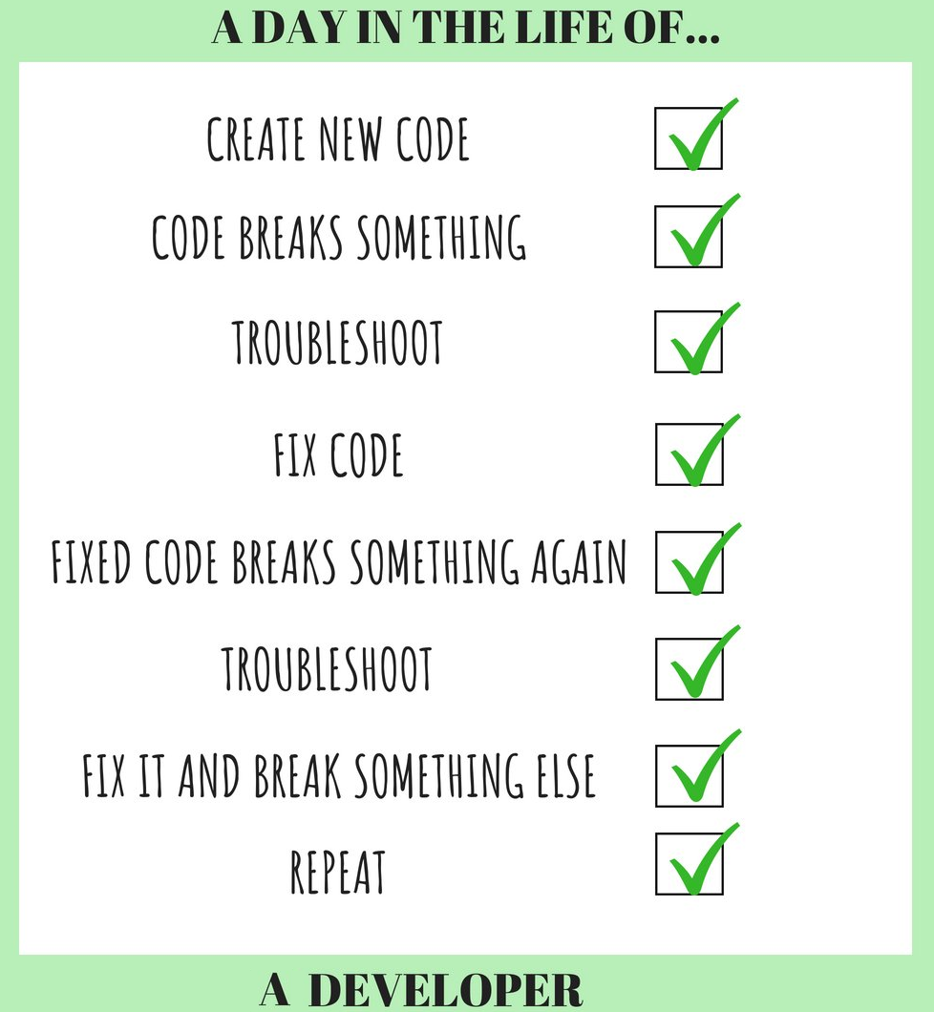
The Prioritization Problem
What should we inspect?
Can’t inspect everything
Reacting to inspections can take some time
Can be too repetitive
Inspect what probably has vulnerabilities
Three approaches:
Code coverage – what have we not tested?
Static analysis – what tools say is vulnerable
Prediction – what history says is vulnerable

Slide 7

Who does the code inspection/review?
Author (Peer)
Made significant contributions to the code recently
Can answer any specific questions
People with readability, but objectivity
e.g. close colleagues
e.g. developer working on a similar feature on the same project, but different team
e.g. system architect
People experienced with security
Consultants, if any
Developers on previous vulnerabilities in this system

Slide 8

Code Coverage
What has been executed as a result of our tests?
e.g. have exceptions been tested?
e.g. have we tested this input?
Use a tool to record what code has been executed
Levels: package, class, line, branch
80% is a common threshold for line coverage
Benefits
Reveals what testers forgot
Relatively simple to deploy and execute
Disadvantages
Unit test coverage != well-tested (add system tests to your coverage!)
Test coverage != security test coverage

Slide 9
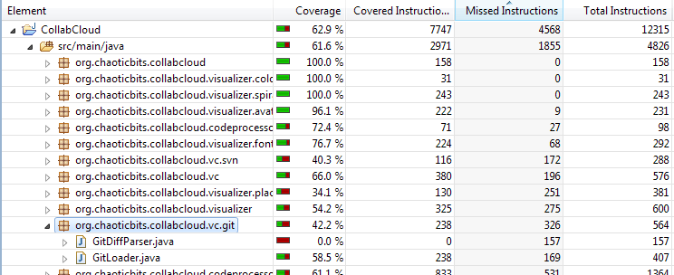
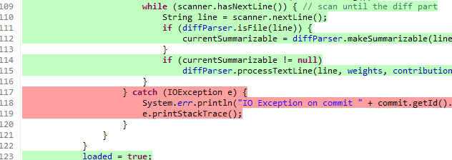
eclEMMA

Slide 10
What is Static Analysis?
Static Code Analysis (also known as Source Code Analysis) is usually performed as part of a Code Review.
It is carried out at the Implementation phase of a project
Static Code Analysis commonly refers to the running of Static Code Analysis tools that attempt to highlight possible vulnerabilities within 'static' (non-running) source code. (OWASP, 2018)
Static Analysis is any analysis done on code without running it
Simplest form is having a colleague review your code, they are not running the code, the manual view it and check for errors.
A bit like asking someone to Proof read a document.
However this is still manual, how do we make it quicker and less time consuming?
Answer: We automate it!

Slide 11
Introduction to Static Analysis tools
Any tool that analyses code without executing it is performing static analysis. (Code/application is not running)
For the purpose of detecting security problems, the variety of static analysis tools we are most interested in are the ones that behave a bit like a spell checker!
They prevent well-understood varieties of mistakes from going unnoticed.
Even good spellers use a spell checker because, invariably, spelling mistakes creep in no matter how good a speller you are.
However! A spell checker won’t catch every slip-up:
If you type blue when you mean blew, a spell checker won’t help!
The sky is blew
Static analysis tools are the same…

Slide 12
How do code mistakes occur?
Security problems can result from the same kind of simple mistakes that lead a good speller to occasionally make a typo:
A little bit of confusion, a momentary lapse, or a temporary disconnect between the brain and the keyboard.
But security problems can also grow out of a lack of understanding about what secure programming entails.
It is not unusual for programmers to be completely unaware of some of the ways that attackers will try to take advantage of a piece of code.
With that in mind, static analysis is well suited to identifying security problems for a number of reasons….

Slide 13
Static Analysis helps to identifying security problems because…
Static Analysis tools apply checks thoroughly and consistently, without any of the bias that a programmer might have about which pieces of code are “interesting” from a security perspective or which pieces of code are easy to exercise through dynamic testing.
Ever asked someone to proofread your work and had them point out an obvious problem that you completely overlooked?
Was your brain automatically translating the words on the page into the words you intended to write? Then you know how valuable an unbiased analysis can be.

Slide 14

Static Analysis helps to identifying security problems because…
By examining the code itself, static analysis tools can often point to the root cause of a security problem, not just one of its symptoms.
This is particularly important for making sure that vulnerabilities are fixed properly.
When the security team reports: “The program contains a buffer overflow. We know it contains a buffer overflow because when we input the letter ‘A’ 50 times in a row, it crashes.”
Only later does the security team find out that the developer has “fixed” the program by adding a check to see if the input consists of exactly the letter ‘A’ 50 !!
If (input.equals(“AAAAAAAAAAAAAAAAAAAAAAAAAAAAAAAAAAAAAAAAAAAAAAAAAA”)

Slide 15
Static Analysis helps to identifying security problems because…
Static analysis can find errors early in development, even before the program is run for the first time.
Finding an error early not only reduces the cost of fixing the error, but the quick feedback cycle can help guide a programmer’s work:
A programmer has the opportunity to correct mistakes he or she wasn’t previously aware could even happen.
The attack scenarios and information about code constructs used by a static analysis tool act as a means of knowledge transfer.
When a vulnerability is discovered, static analysis tools make it easy to recheck a large body of code to see where the new attack might succeed.
Some security defects exist in software for years before they are discovered, which makes the ability to review legacy code for newly discovered types of defects invaluable.

Slide 16
Solving Problems with Static Analysis Tools
Static analysis is used more widely than many people realise, partially because there are many kinds of static analysis tools, each with different goals.
Different tools examine different areas for static analysis tools, such as:
Type checking
Style checking
Bug finding
Security review

Slide 17
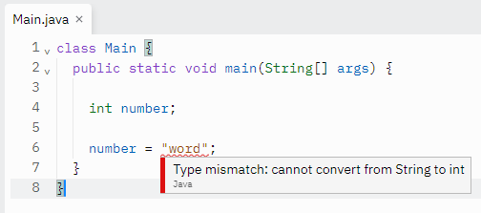
Type Checking
The most widely used form of static analysis, and the one that most programmers are familiar with
Most developers, don’t think too much about type checking.
because, the rules are typically defined by the programming language and enforced by the compiler.
Type checking can eliminates entire categories of programming mistakes.
By catching errors at compile time, type checking prevents runtime errors.

Slide 18
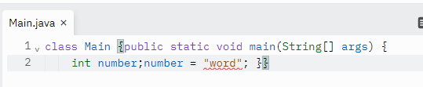
Style Checking
Style checkers are also static analysis tools.
They generally enforce a pickier and more superficial set of rules than a type checker.
Pure style checkers enforce rules related to whitespace, naming, deprecated functions, indentation, commenting, program structure, etc.
Because many programmers are fiercely attached to their own version of good style, most style checkers are quite flexible about the set of rules they enforce, the tools can be customised.
The errors produced by style checkers often affect the readability and the maintainability of the code but do not indicate that a particular error will occur when the program runs.

Slide 19
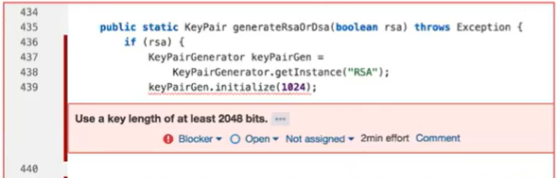
Security Review
Security-focused static analysis tools use many of the same techniques found in other tools, but their more focused goal (identifying security problems) means that they apply these techniques differently.
Security tools tend to err on the side of caution and point out bits of code that should be subject to manual review even if the tool cannot prove that they represent exploitable vulnerabilities.
This means that the output from a security tool still requires human review and is best applied as part of a code review process.

Slide 20
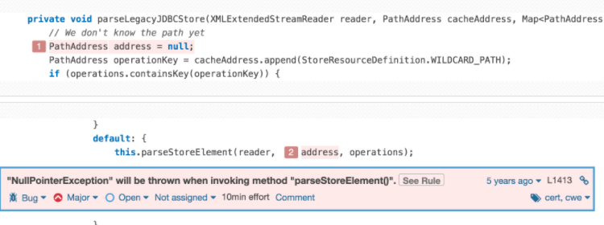
Bug Finding
The purpose of a bug finding tool is not to complain about formatting issues, like a style checker, nor is it to perform a complete and exhaustive comparison of the program against a specification, as a program verification tool would.
Instead, a bug finder simply points out places where the program will behave in a way that the programmer did not intend.
Most bug finders are easy to use because they come loaded with a set of rules that describe patterns in code that often indicate bugs.

Slide 21


What can the tools do?
What can they not do?
A static source code analyser can:
Look for known and common errors
Sometimes suggest fixes or improvements
Offer help in finding bugs
Find many kinds of bugs, not only security related
A static source code analyser cannot:
‘Automagically’ fix bugs
Find all bugs (i.e. false negatives)
Find only bugs (i.e. false positives)

Slide 22


Static Analysis Benefits & Drawbacks
Benefits
Quick and easy
Knowledge transfer from experts behind the tool
Automation - can save your time and energy which ultimately will help you to release your software faster.
Security - by adopting Static analysis you can cut the doubt of security vulnerabilities in your application.
Implementation - used early in the SDLC, it will give more time to fix the issues discovered by the tool.
Drawbacks
Biased to code-level vulnerabilities
Cannot possibly identify domain-specific risks
Better for inspections than tests
High false positive rates: >90% are FP in many cases

Slide 23

False positives
A false positive is a problem reported in a program when no problem actually exists.
A large number of false positives can cause real difficulties.
Examining a long list of false positives, can be an exhaustive task.
A programmer who has to look through a long list of false positives might overlook important results that are buried in the list.
False positives are certainly undesirable, but from a security perspective, false negatives are much worse.
With a false negative, a problem exists in the program, but the tool does not report it!!
The penalty for a false positive is the amount of time wasted while reviewing the result.
The penalty for a false negative is far greater!

Slide 24
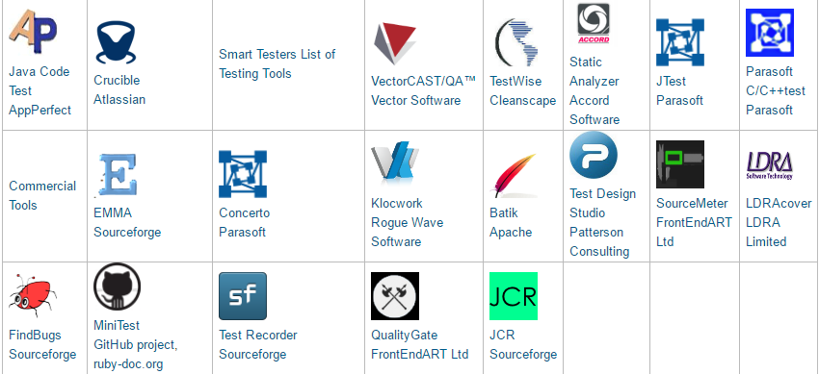
Static Analysis Tools
There are many tools for all languages that can perform static analysis. You should use one that best suits your needs.
Top Free Static Code Analysis Tools

Slide 25
What else?
‘Ok, now that I have used this tool, I should be safe…’
Tools are not enough!
Even the best tool will miss the most sophisticated errors
Sensitive projects should be reviewed ‘manually’ by experts

Slide 26
Bibliography
https://www.owasp.org/index.php/Static_Code_Analysis
https://www.guru99.com/white-box-testing.html
Book : Secure programming with Static Analysis(Chess & West, 2007) Addison-Wesley Professional

Slide 27

Practical/Lab this week is part of your CA!!!
See Blackboard for details of this weeks Lab work

